Slide 1

LiDAR-based Canopy Cover prediction
July 26th Update
Alejandro Donaire Èric Sánchez Pau Ventura

Slide 2
Two main tasks left
Final
cluster
executions
Finish
writing
paper

Slide 3
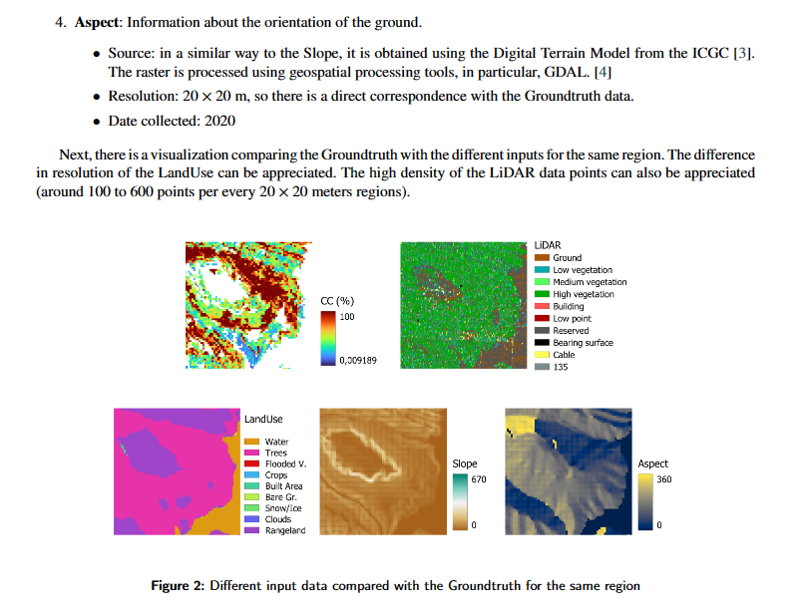
The paper
There are 8 sections
First 3 sections finished essentially
Rest of the sections in progress, already know what to say
Some sections waiting for the final executions

Slide 4
Final cluster executions: optimized a great deal
We had problems with memory → Reached 100% and stopped
Optimized data types → 4.8% less memory per every 24 blocks
Merging big .tiff files after preprocessing
Make sure there are not unnecessary copies
Isolate processes as much as possible
+50% faster
approximately

Slide 5
Final cluster executions
Feature selection already executing
Next:
Hyperparameter search once FE done
Try with as much blocks as possible
Think about what’s the best number of blocks

